Slide 1
Introduction to HTML

Slide 2
Outline
Introduction to HTML
Basic Structure of a HTML page
Text formatting tags in HTML
Lists in HTML

Slide 3
1. Introduction to HTML…
HTML – Hyper-Text Markup Language – The Language of Web Pages on the World Wide Web
It defines the structure of webpages and determines how data is displayed online
HTML is a text formatting language
Is a set of special instructions that can be added in the text to add formatting and linking information
Is directly interpreted by the browser

Slide 4
1. Introduction to HTML…
Hypertext:
Allows for non-linear linking to other documents
Markup Language:
Content is “marked up” or tagged to tell the browser how to display it
HTML standards are developed under the authority of the World Wide Web Consortium (W3C), headed by Tim Lee
http://www.w3c.org

Slide 5
1. Introduction to HTML…
HTML was created in 1991 by Tim Berners-Lee at CERN in Switzerland
It was designed to allow scientists to display and share their research
1995- HTML 2
lots of browsers had added their own bits to HTML
Dan Connolly and colleagues collected all the HTML tags that were widely used and collated them into a draft document

Slide 6
1. Introduction to HTML…
1997- HTML 3.2
It was the first version developed and standardized exclusively by the W3C
HTML 3.2 included the support for applets, text flow around images, subscripts and superscripts etc
1999 – HTML 4.1
extends HTML with mechanisms for style sheets, scripting, frames etc.
HTML5

Slide 7
1. Introduction to HTML…
HTML Tags:
Tags are instruction that are directly embedded into the text of the document
Is a signal to a browser to do something before just throwing text on the screen
Begin with open angle bracket < and ends with close angle bracket >
For example <HTML>
Paired Tags : <HTML> </HTML>
Singular Tags: <BR>

Slide 8
1. Introduction to HTML…
HTML is not case-sensitive
multiple spaces will appear as a single space
Blank and new lines are ignored
<!-- comments -- >
HTML files have .html extension

Slide 9
2. Structure of HTML Page
The entire web page is enclosed within <HTML> and </HTML>
Within these tags two distinct sections are created head and body
Head: <HEAD>
<TITLE> …… </TITLE>
</HEAD>
. Body: indicate the start and end of main body of textual information
<BODY>
</BODY>

Slide 10
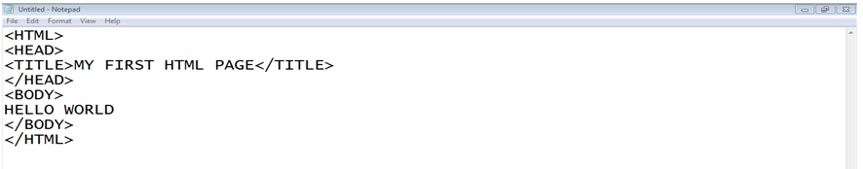
2. Structure of HTML Page…
First HTML page:

Slide 11
3. The BODY Tag
Attributes:
BGCOLOR: Change the background color
BACKGROUND: Place an image at background
TEXT: Change the color of the body text
Example:
<BODY BGCOLOR=123345 TEXT=Red>
<BODY BACKGROUND=“img.jpg” TEXT=Red>

Slide 12
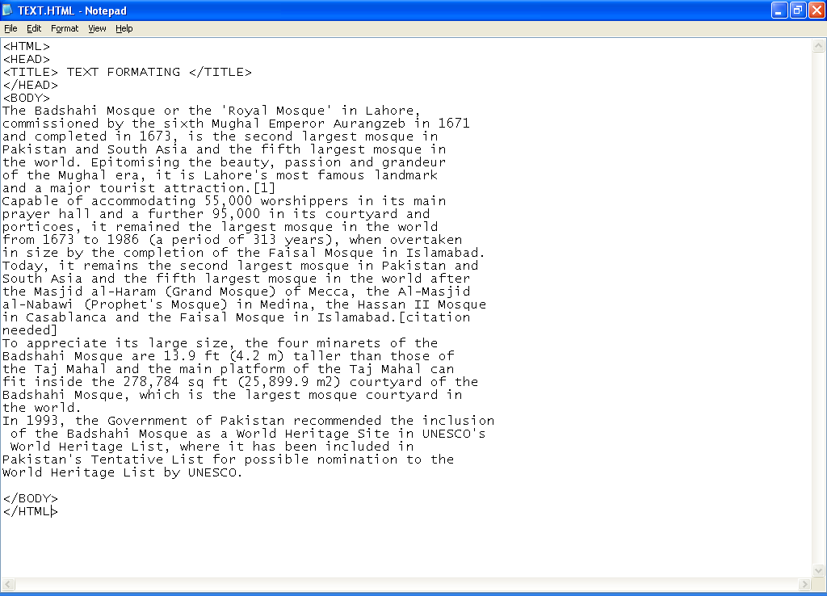
4. Formatting text

Slide 13
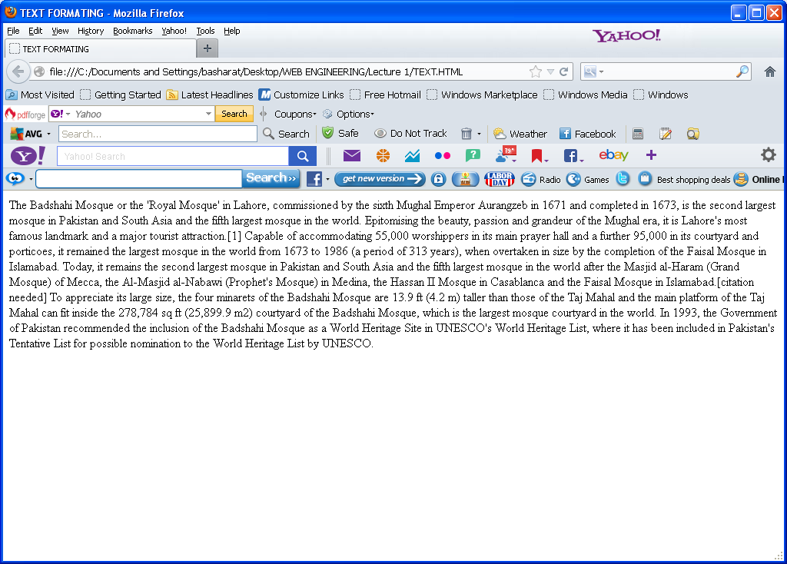
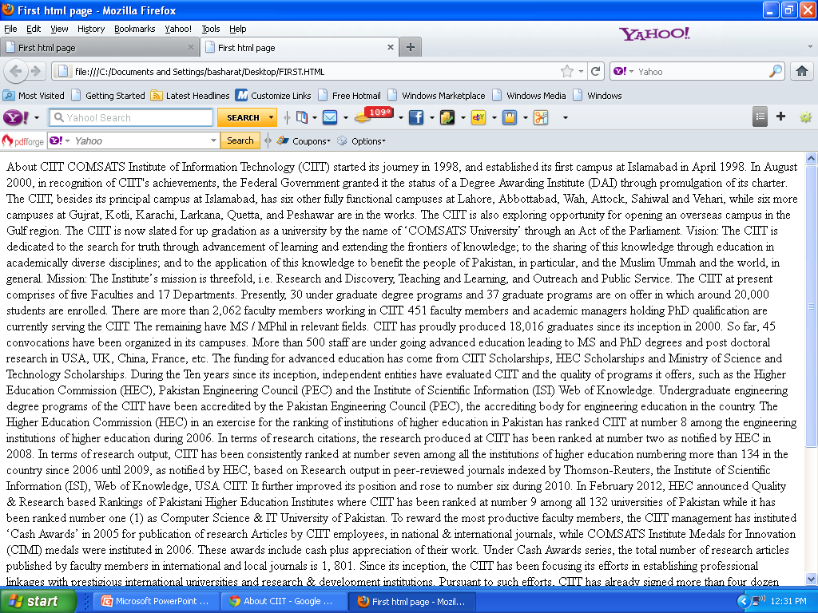
Formatting Text…...

Slide 14
4. Formatting text…
<P>….. </p>: starts a new paragraph
Align (left, right, center and justify)
<BR>: gives an one line break
<H1> ….. </H1>: heading
<HR>: draws horizontal line
ALIGN (LEFT,CENTER,RIGHT)
SIZE=2
WIDTH=100%
color
Text Styles:
<B> …. </B> , <I> …. </I>, <U> …. </U>

Slide 15
4. Formatting text…
<CENTER>….</CENTER>
<FONT>……</FONT>
FONTFACE: Sets the specified font name
SIZE: Size of the text (between 1 and 7)
COLOR: Set the color of the text
Example:
<FONT FONTFACE=“COMIC SANS MS” SIZE=6 COLOR=RED> Welcome</FONT>

Slide 16
5. Lists in HTML
Un-ordered Lists:
Starting Tag <UL>, Ending Tag </UL>
List Items <LI>
Type (FILLROUND, SQUARE)
Ordered Lists:
Starting Tag <OL>, Ending Tag </OL>
List Items <LI>
Type (“1”, “A”, ‘”a”, ”I”, ”i”)
Start (Alerts the numbering Sequence)
Value (Changes the number sequence in the middle of an ordered list)

Slide 17
5. Lists in HTML…
Definition Lists:
Starting Tag<DL>
Ending Tag </DL>
Definition Term <DT>
Definition Description <DD>

Slide 18
Summary
What is HTML?
Basic Structure of HTML page
Body tag attributes
Text formatting tags
Lists

Slide 19
References
Chapter 1, Beginning HTML, XHTML,CSS, and JavaScript, by Jon Duckett, Wiley Publishing; 2009, ISBN: 978-0-470-54070-1.

